Slide 1
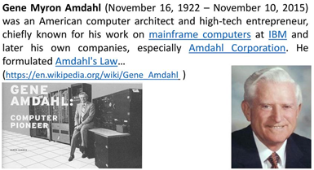
Amdahl's law
“The overall performance improvement gained by optimizing a single part of a system is limited by the fraction of time that the improved part is actually used”.

Slide 2
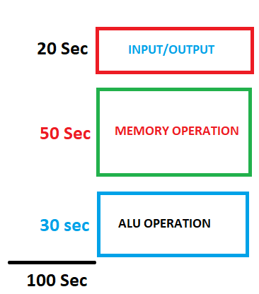
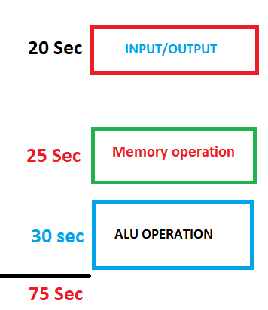

Speed up
New system
(Memory upgraded only)
Old system
= 100/75 = 1.33

Slide 3
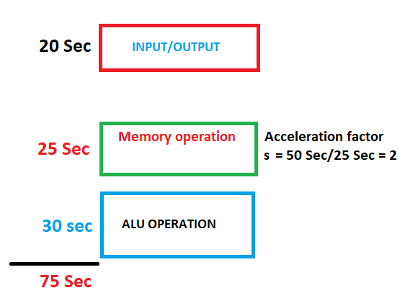
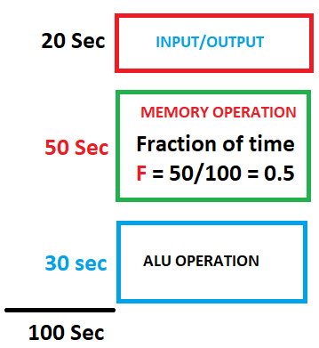

Old system
New system(Memory upgraded only)
Normalized Rum time = 1
Amdahl’s law
= 100/75 = 1.33

Slide 4
Amdahl's law
Amdahl's law is often used in parallel computing to predict the theoretical speedup when using multiple processors.
For example, if a program needs 20 hours to complete using a single thread, but a one-hour portion of the program cannot be parallelized, therefore only the remaining 19 hours execution time can be parallelized, then regardless of how many threads are devoted to a parallelized execution of this program, the minimum execution time cannot be less than one hour.
Hence, the theoretical speedup is limited to at most 20 times the single thread performance

Slide 5
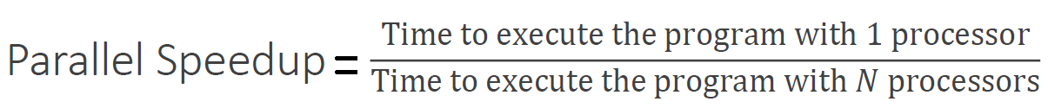
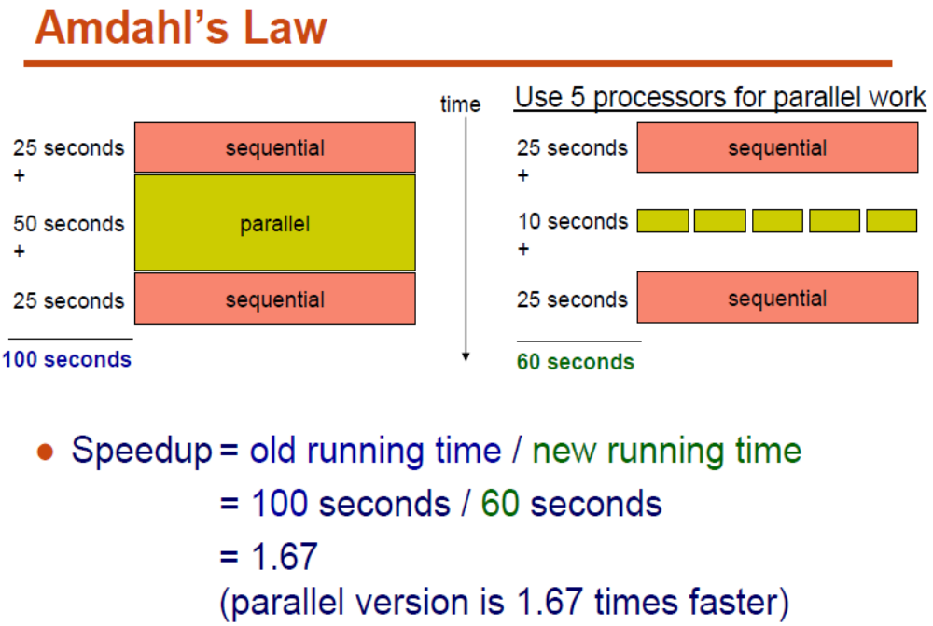
Parallel Architecture

Slide 6
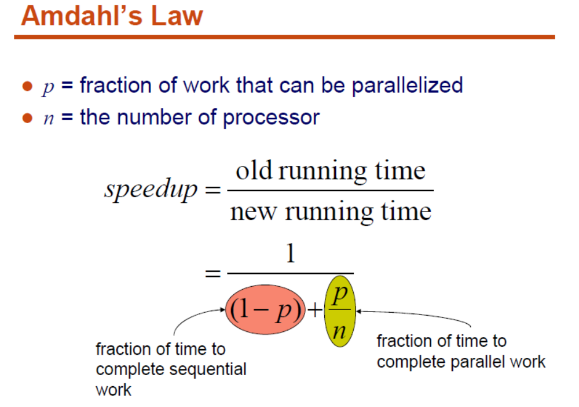

Slide 7
Amdahl’s Law
Enhancement E accelerates fraction F of original execution time by a factor of S
Before:
Execution Time without enhancement E: (Before enhancement is applied)
shown normalized to 1 = (1-F) + F =1
Unaffected fraction: (1- F)
Affected fraction: F
Unchanged
Unaffected fraction: (1- F)
F/S
After:
Execution Time with enhancement E:
What if the fraction given is
after the enhancement has been applied?
How would you solve the problem?
(i.e find expression for speedup)
Execution Time without enhancement E 1
Speedup(E) = ------------------------------------------------------ = ------------------
Execution Time with enhancement E (1 - F) + F/S

Slide 8
Amdahl's Law
The performance enhancement possible due to a given design improvement is limited by the amount that the improved feature is used
  Performance improvement or speedup due to enhancement E:
Execution Time without E Performance with E
Speedup(E) = -------------------------------------- = ---------------------------------
Execution Time with E Performance without E
  Suppose that enhancement E accelerates a fraction F of the execution time by a factor S and the remainder of the time is unaffected then:
Execution Time with E = ((1-F) + F/S) X Execution Time without E
Hence speedup is given by:
Execution Time without E 1
Speedup(E) = --------------------------------------------------------- = --------------------
((1 - F) + F/S) X Execution Time without E (1 - F) + F/S
original

Slide 9
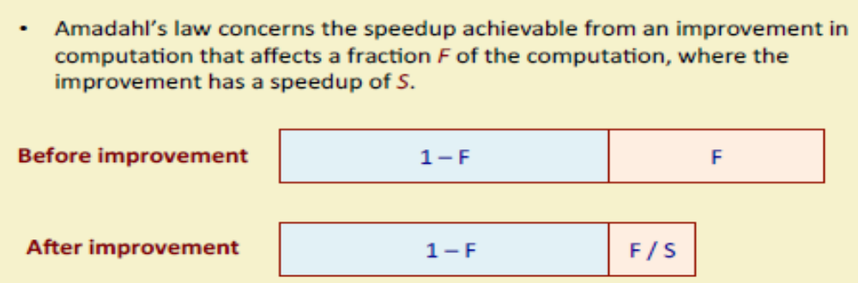
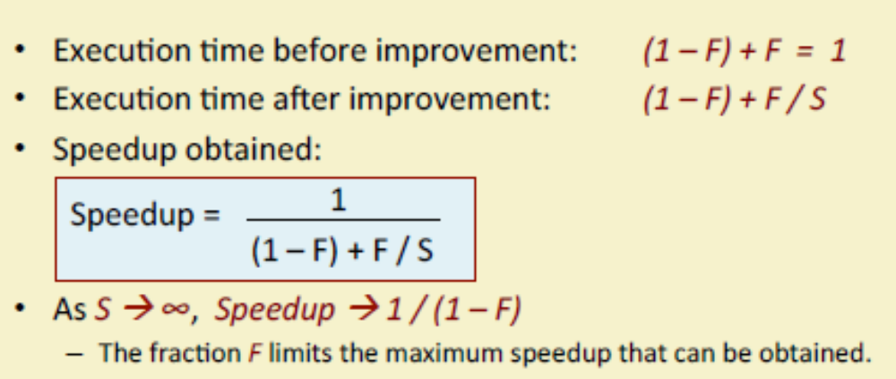
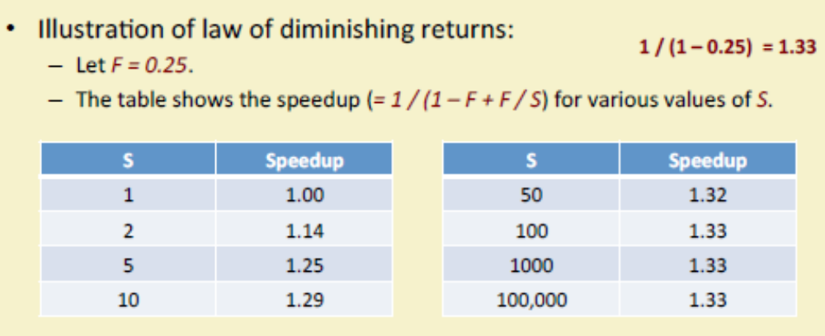

Slide 10
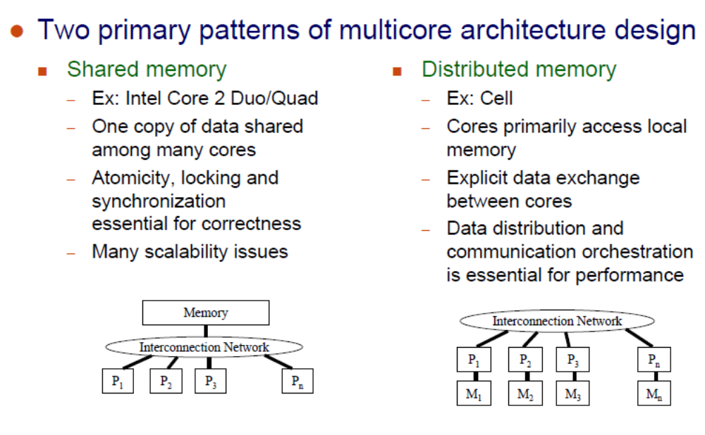

Slide 11
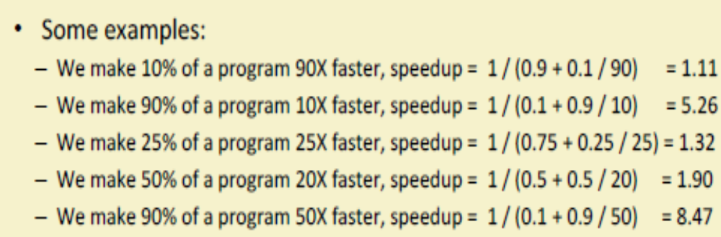

Slide 12
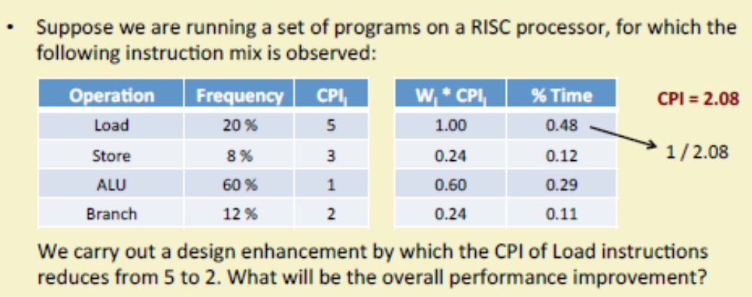
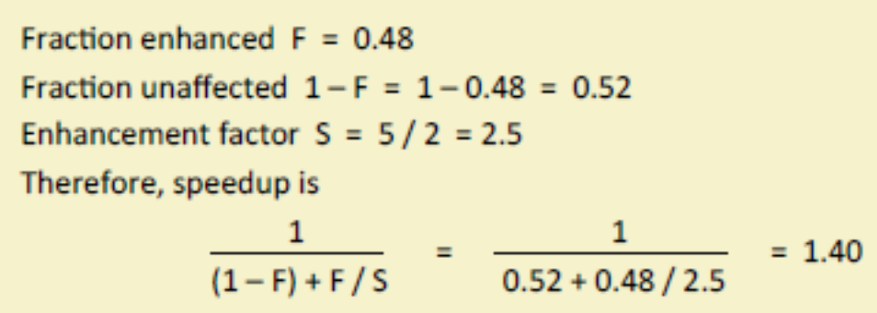
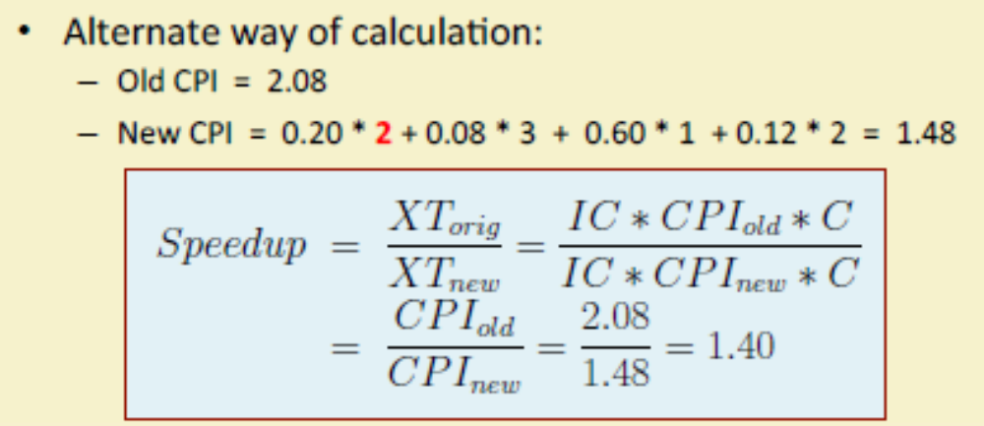

Slide 13
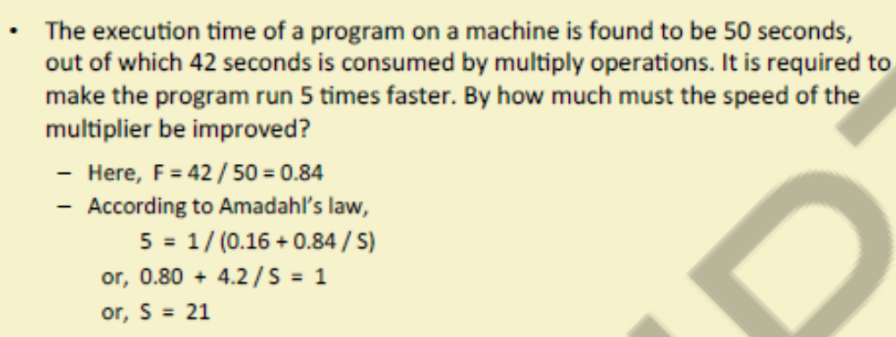
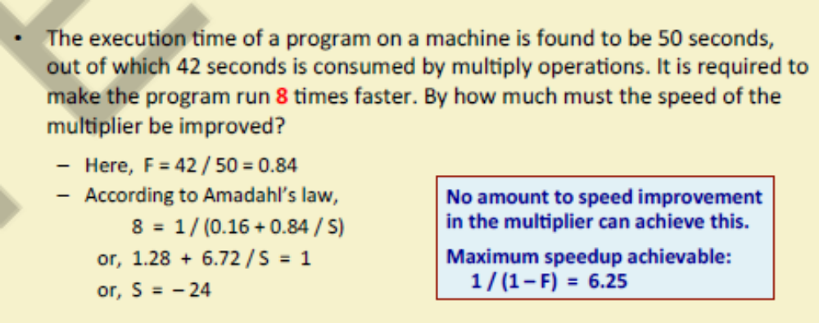

Slide 14
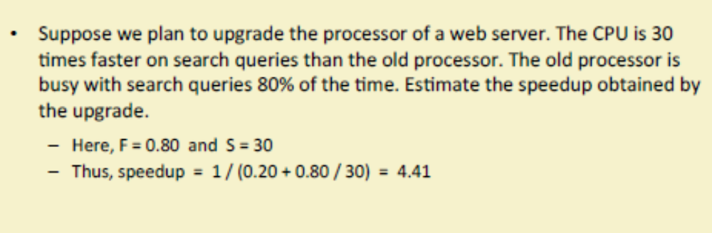

Slide 15
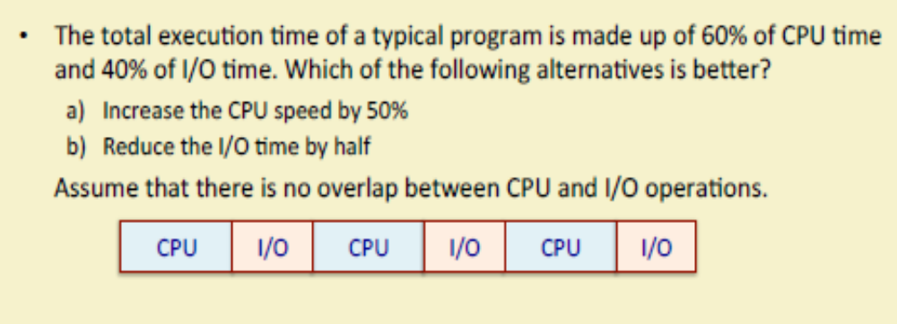
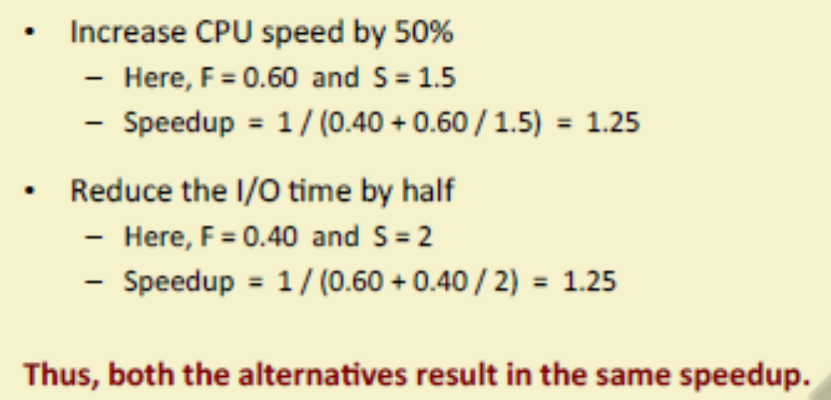

Slide 16
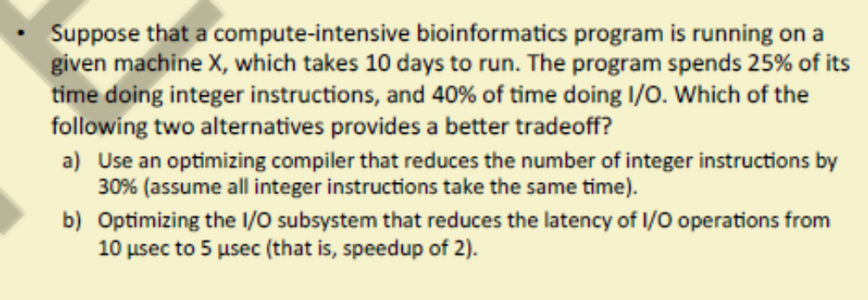
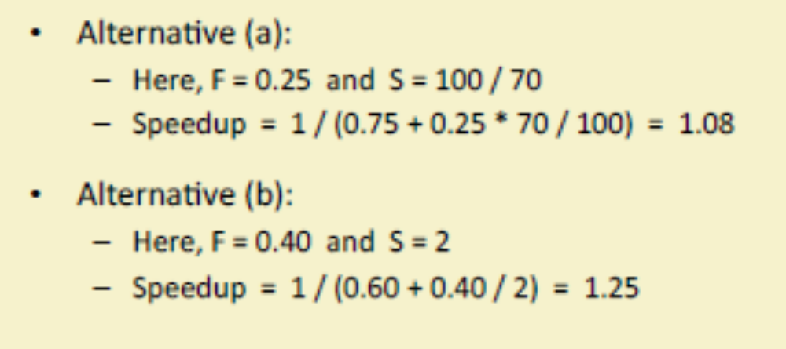

Slide 17
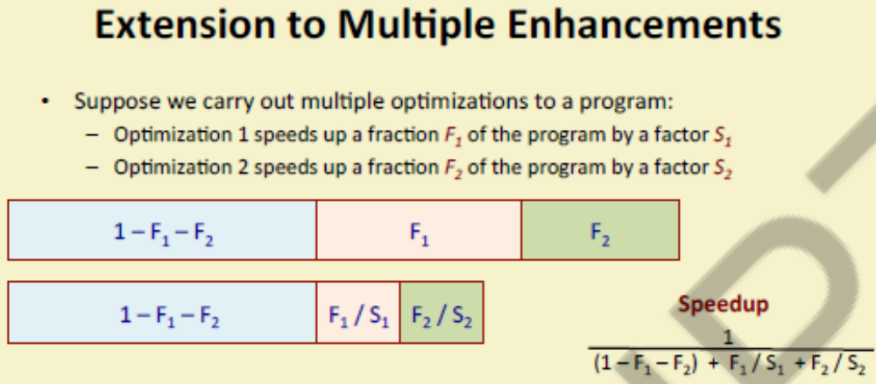
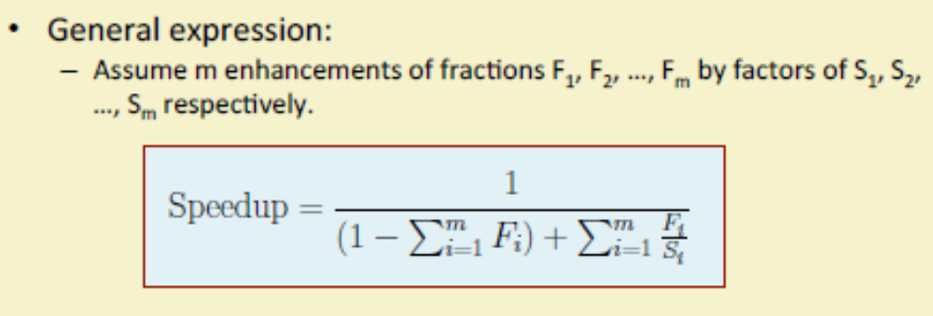

Slide 18
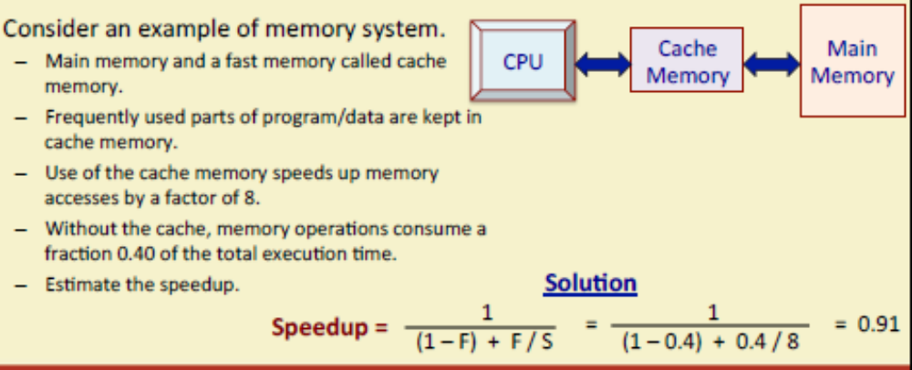
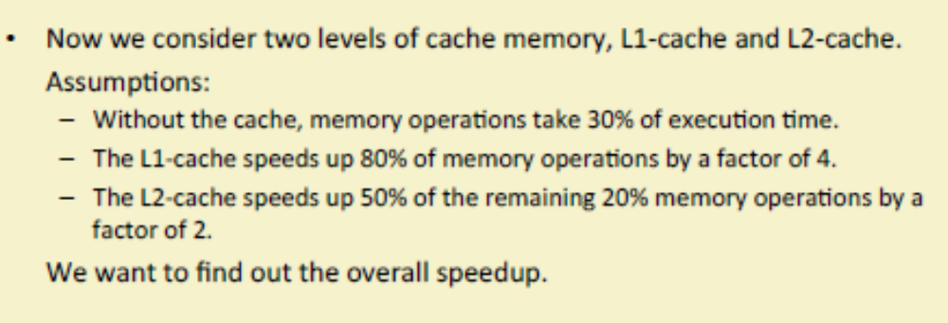
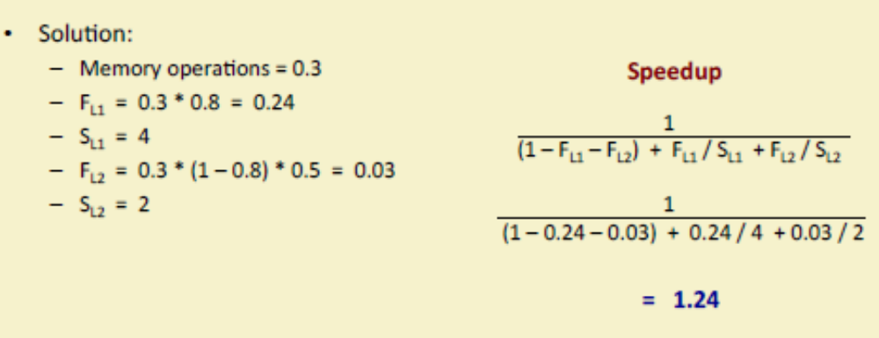

Slide 19
Performance Enhancement Example
For the RISC machine with the following instruction mix given earlier:
    Op Freq Cycles CPI(i) % Time
    ALU 50% 1 .5 23%
    Load 20% 5 1.0 45%
    Store 10% 3 .3 14%
  Branch 20% 2 .4 18%
If a CPU design enhancement improves the CPI of load instructions from 5 to 2, what is the resulting performance improvement from this enhancement:
Fraction enhanced = F = 45% or .45
Unaffected fraction = 1- F = 100% - 45% = 55% or .55
Factor of enhancement = S = 5/2 = 2.5
Using Amdahl’s Law:
1 1
Speedup(E) = ------------------ = --------------------- = 1.37
(1 - F) + F/S .55 + .45/2.5
CPI = 2.2

Slide 20
An Alternative Solution Using CPU Equation
    Op Freq Cycles CPI(i) % Time
    ALU 50% 1 .5 23%
    Load 20% 5 1.0 45%
    Store 10% 3 .3 14%
  Branch 20% 2 .4 18%
If a CPU design enhancement improves the CPI of load instructions from 5 to 2, what is the resulting performance improvement from this enhancement:
Old CPI = 2.2
New CPI = .5 x 1 + .2 x 2 + .1 x 3 + .2 x 2 = 1.6
Original Execution Time Instruction count x old CPI x clock cycle
Speedup(E) = ----------------------------------- = ----------------------------------------------------------------
New Execution Time Instruction count x new CPI x clock cycle
old CPI 2.2
= ------------ = --------- = 1.37
new CPI 1.6
Which is the same speedup obtained from Amdahl’s Law in the first solution.
CPI = 2.2
New CPI of load is now 2 instead of 5
T = I x CPI x C

Slide 21
Performance Enhancement Example
A program runs in 100 seconds on a machine with multiply operations responsible for 80 seconds of this time. By how much must the speed of multiplication be improved to make the program four times faster?
100
Desired speedup = 4 = -----------------------------------------------------
Execution Time with enhancement
→ Execution time with enhancement = 100/4 = 25 seconds
25 seconds = (100 - 80 seconds) + 80 seconds / S
25 seconds = 20 seconds + 80 seconds / S
→ 5 = 80 seconds / S
→ S = 80/5 = 16
Alternatively, it can also be solved by finding enhanced fraction of execution time:
F = 80/100 = .8
and then solving Amdahl’s speedup equation for desired enhancement factor S
Hence multiplication should be 16 times
faster to get an overall speedup of 4.
1 1 1
Speedup(E) = ------------------ = 4 = ----------------- = ---------------
(1 - F) + F/S (1 - .8) + .8/S .2 + .8/s
Solving for S gives S= 16
Machine = CPU

Slide 22
Performance Enhancement Example
For the previous example with a program running in 100 seconds on a machine with multiply operations responsible for 80 seconds of this time. By how much must the speed of multiplication be improved to make the program five times faster?
100
Desired speedup = 5 = -----------------------------------------------------
Execution Time with enhancement
→ Execution time with enhancement = 100/5 = 20 seconds
20 seconds = (100 - 80 seconds) + 80 seconds / s
20 seconds = 20 seconds + 80 seconds / s
→ 0 = 80 seconds / s
No amount of multiplication speed improvement can achieve this.

Slide 23
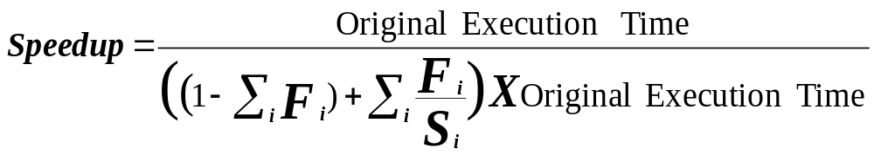
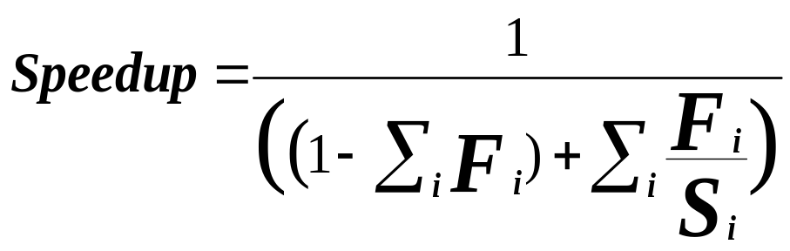
Extending Amdahl's Law To Multiple Enhancements
n enhancements each affecting a different portion of execution time
Suppose that enhancement E_{i} accelerates a fraction F_{i} of the original execution time by a factor S_{i} and the remainder of the time is unaffected then:
i = 1, 2, …. n
Unaffected fraction
What if the fractions given are
after the enhancements were applied?
How would you solve the problem?
(i.e find expression for speedup)
Note: All fractions F_{i} refer to original execution time before the
enhancements are applied.

Slide 24
Amdahl's Law With Multiple Enhancements: Example
Three CPU performance enhancements are proposed with the following speedups and percentage of the code execution time affected:
Speedup₁ = S₁ = 10 Percentage₁ = F₁ = 20%
Speedup₂ = S₂ = 15 Percentage₁ = F₂ = 15%
Speedup₃ = S₃ = 30 Percentage₁ = F₃ = 10%
While all three enhancements are in place in the new design, each enhancement affects a different portion of the code and only one enhancement can be used at a time.
What is the resulting overall speedup?
Speedup = 1 / [(1 - .2 - .15 - .1) + .2/10 + .15/15 + .1/30)]
= 1 / [ .55 + .0333 ]
= 1 / .5833 = 1.71

Slide 25
Pictorial Depiction of Example
Before:
Execution Time with no enhancements: 1
i.e normalized to 1
S₁ = 10
S₂ = 15
S₃ = 30
Unaffected, fraction: .55
F₁ = .2
F₂ = .15
F₃ = .1
/ 10
/ 15
/ 30
Unchanged
Unaffected, fraction: .55
After:
Execution Time with enhancements: .55 + .02 + .01 + .00333 = .5833
Speedup = 1 / .5833 = 1.71
Note: All fractions F_{i} refer to original execution time.
What if the fractions given are
after the enhancements were applied?
How would you solve the problem?

Slide 26
http://www.eecs.harvard.edu/cs146-246/

